Slide 1
Technology Overview
Zoiner Tejada
Notes:
Abstract and learning objectives
Brief review of technologies and concepts featured in design challenge.

Slide 2
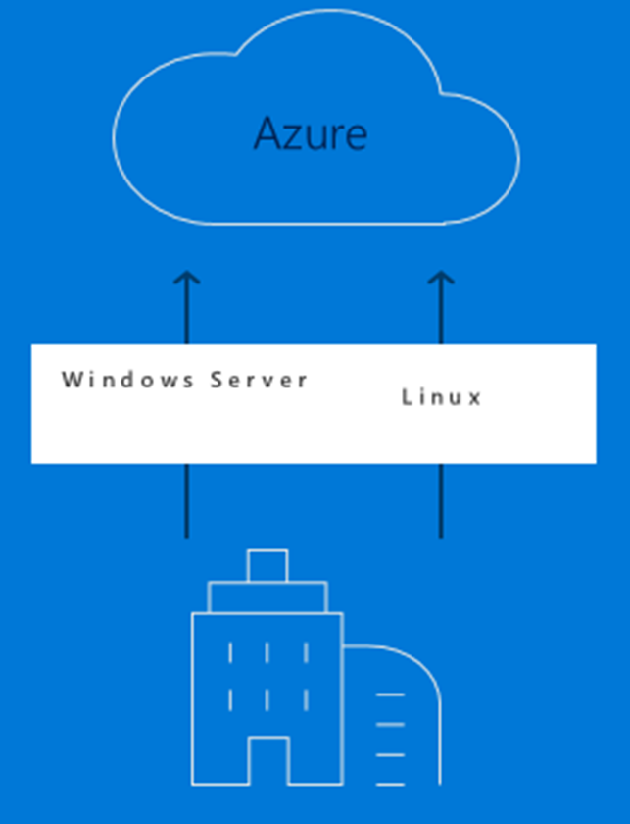
Common scenarios: Azure migrate
Discoverability Easily discover VMWare VMs and applications, including service dependencies
Workload assessments
Right-size Azure resources based on utilization history
Estimate monthly costs in Azure
Migration risks and recommended tools
Hyper-V support (coming soon)
Leverage Azure Site Recovery Deployment Planner or partner tools for these workloads
Notes:
Easily discover VMWare VMs and applications including service dependencies
Workload assessments
Right-size Azure resources based on utilization history
Estimate monthly costs in Azure
Migration risks and recommended tools
Hyper-V support coming soon
Leverage Azure Site Recovery Deployment Planner or partner tools for these workloads
https://docs.microsoft.com/en-us/azure/migrate/migrate-overview#current-limitations
Note that support for Hyper-V is on the roadmap.
Hyper-V
Partner tools

Slide 3

Common scenarios: Database migration
Migrate from multiple database sources to Azure Data platforms with minimal downtime
Generate assessments of all recommended changes
Perform associated migration steps
Notes:
Migrate from multiple database sources to Azure Data platforms with minimal downtime
Generate assessments of all recommended changes
Perform associated migration steps

Slide 4
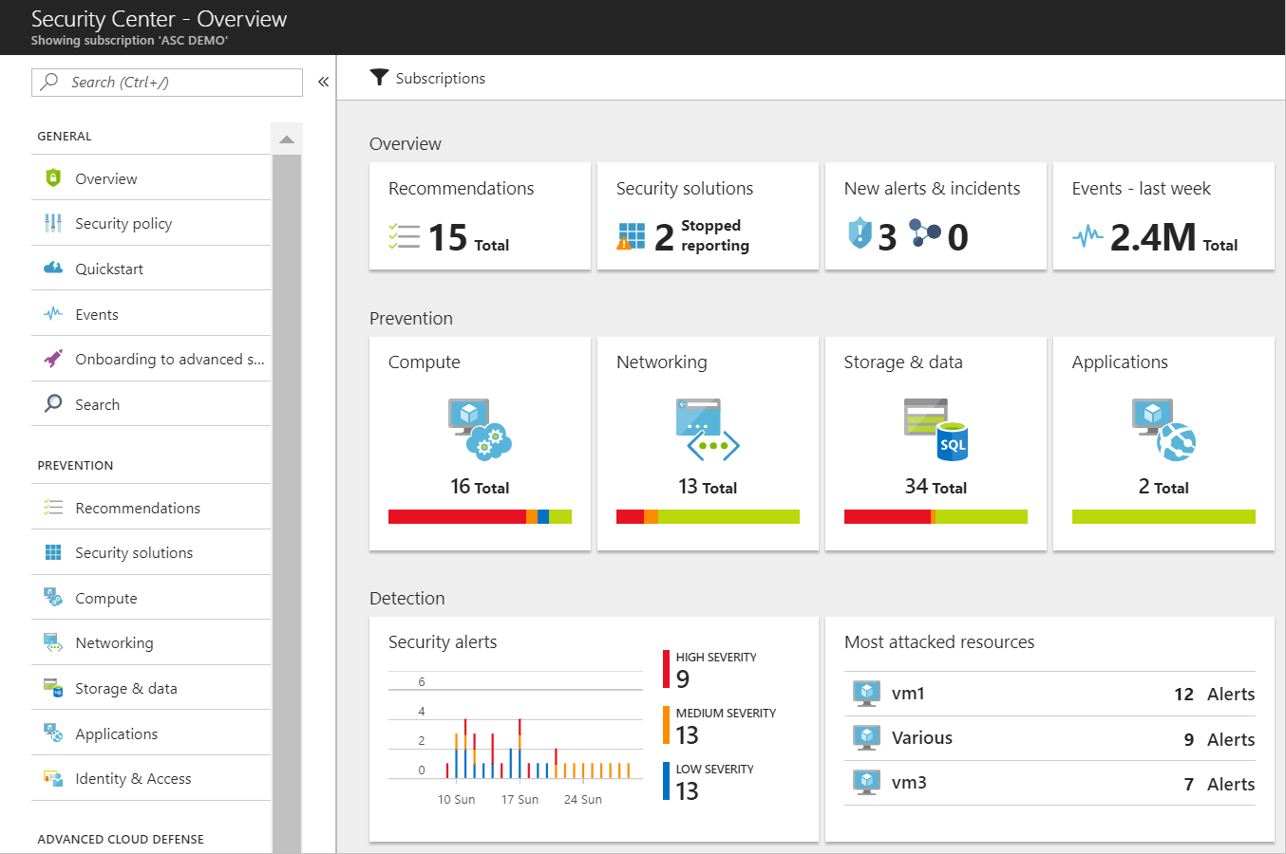
Common scenarios: Azure Security Center
Unified view of security across on-premises and cloud workloads.
Identify and remediate vulnerabilities
Advanced threat protection
Centralized security policies
Notes:
Unified view of security across on-premises and cloud workloads.
Identify and remediate vulnerabilities
Advanced threat protection
Centralized security policies

Slide 5
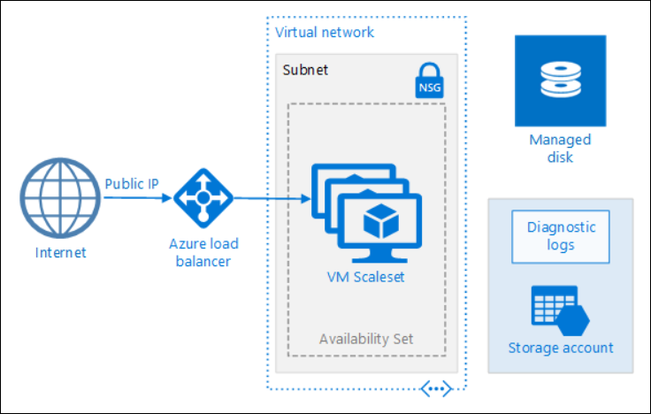
Common scenarios: Azure Virtual Machine Scale Sets

Slide 6
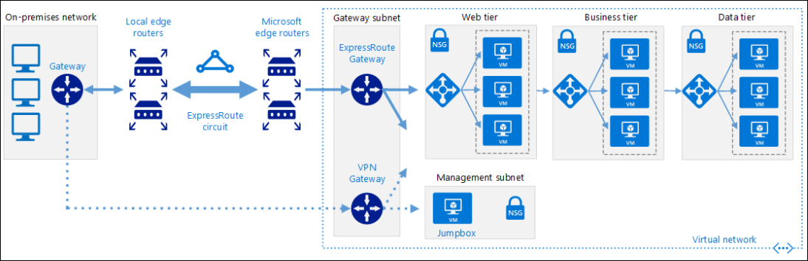
Common scenarios: ExpressRoute with VPN failover

Slide 7
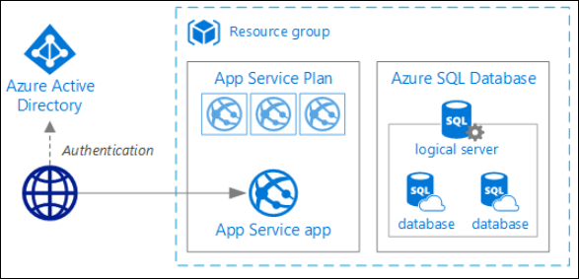
Common scenarios: Azure App Service

Slide 8

Common scenarios: Azure Database for MySQL

Slide 9
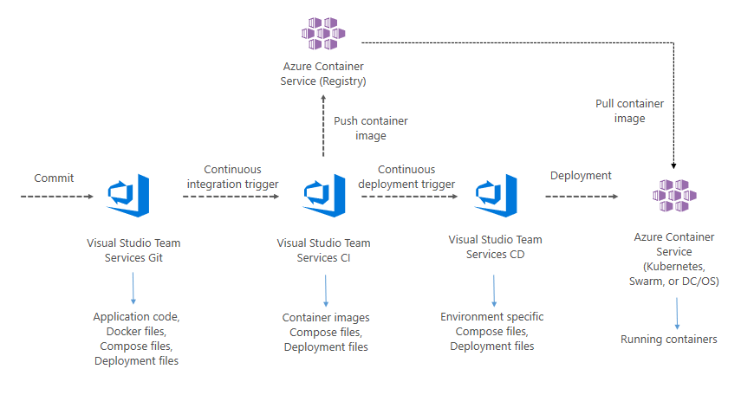
Common scenarios: VSTS for CICD to AKS
Azure Kubernetes Service (AKS)

Slide 10
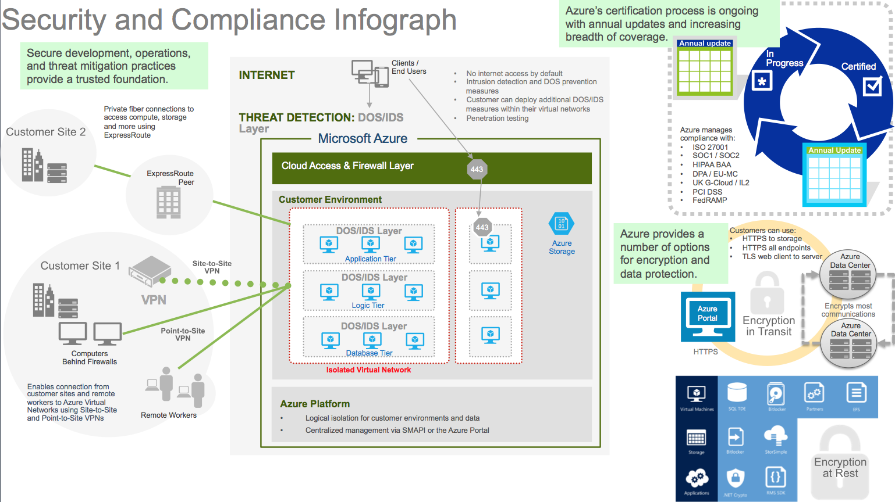
Common scenarios: Security and compliance

Slide 11
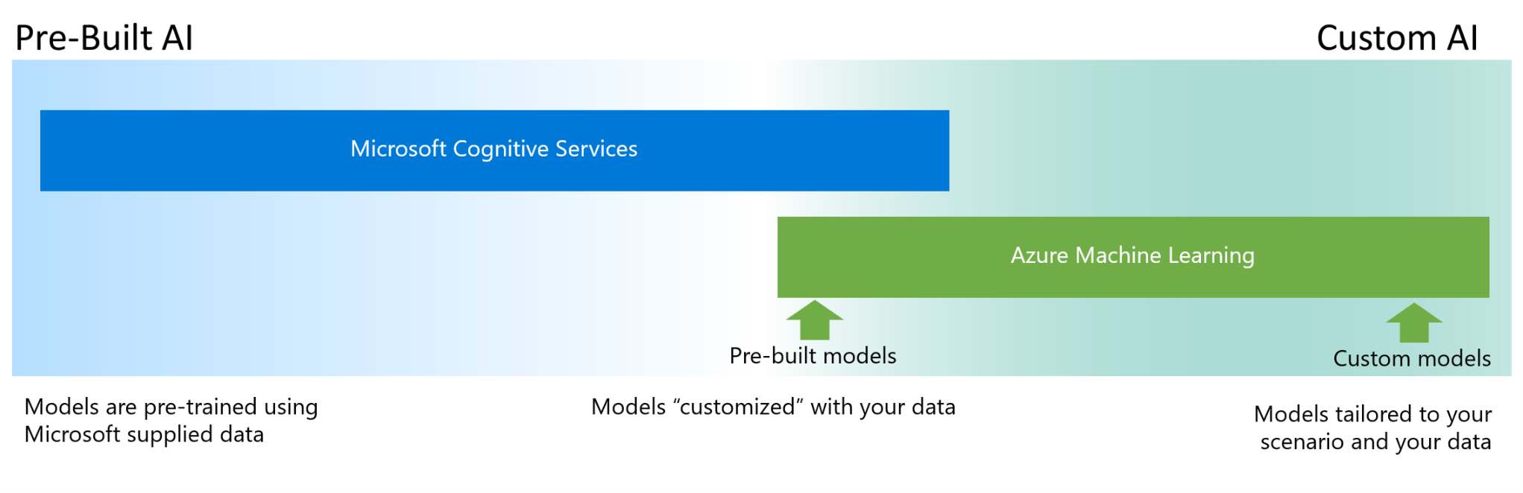
Common scenarios: AI Spectrum

Slide 12

On to the Design Challenge!

